Slide 1
MINE SAFETY DEVICE
Real-time Monitoring for Mine Safety and Urban Pollution

Slide 2
TEAM MEMBERS(EEE 4th Year)
SUJOY MUHURI -16902821054(Team Lead)
ADRIJA CHATTOPADHYAY – 16902821009(Team Member)
DEV JYOTI CHAKRABORTY – 16902821016(Team Member)
DEBANGSHI PALIT- 16902821011(Team Member)

Slide 3
Project Guide
Prof. Abhijit Patra
Associate Professor Dept. of Electrical and Electronics Engineering Academy Of Technology

Slide 4
CONTENTS
Abstract
1
Introduction
2
Review of previous work
3
Design and Simulation
4
Results
5
Future work
6
Conclusion
7

Slide 5
ABSTRACT
Our project presents a cost-effective air quality monitoring system, utilizing a microcontroller integrated with various sensors to provide real-time environmental data. By employing gas, temperature, and humidity sensors, the system continuously monitors air quality and environmental conditions, transmitting data for analysis and display. The primary objective is to raise awareness and ensure public safety by delivering accurate, real-time data on air pollution levels. This is achieved through seamless connectivity using a Wi-Fi module and cloud-based ThingSpeak platform for remote monitoring. The system’s simplicity and affordability make it ideal for both urban and rural applications, offering accessible and scalable environmental tracking. This project empowers users, communities, and authorities to take proactive steps in addressing air pollution and ensuring a healthier environment.

Slide 6
INTRODUCTION:
A Mine Safety Device is a network of technologies and methods designed to measure and track the quality of the air in a specific environment, such as urban areas, industrial sites, or indoor spaces. The primary goal of an air monitoring system is to detect and quantify pollutants, harmful gases, and particulate matter in the air, providing vital data for decision-making and policy implementation.

Slide 7
PROBLEM STATEMENT:
Air pollution poses serious health risks and environmental challenges, yet real-time data on air quality is often limited or unavailable in many areas. Traditional monitoring stations are costly, stationary, and not suitable for widespread or personal use. In many residential, industrial, and remote settings, it becomes difficult to assess the air quality and environmental conditions without access to compact and connected monitoring solutions.
An IoT-based air quality monitoring system that uses gas sensors, temperature and humidity sensors, and a Wi-Fi module can provide real-time data by transmitting readings to an online platform like Thing Speak. This enables users to monitor and analyze air quality from anywhere, empowering informed decisions and timely action to protect health and safety.

Slide 8
REVIEW OF PREVIOUS WORK:
Aravindhar, D. J. (2019, November). Iot Based Air Pollution Monitoring System Using Esp8266-12. ➢
Kim, S. H., Jeong, J. M., Hwang, M. T., & Kang, C. S. (2017, October). Development of an IoT-based atmospheric environment monitoring system.
Al Ahasan, M. A., Roy, S., Saim, A. H. M., Akter, R., & Hossain, M. Z. (2018). Arduino-Based real time air quality and pollution monitoring system.

Slide 9
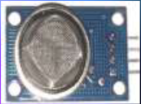
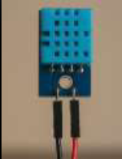
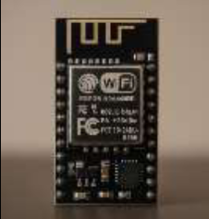

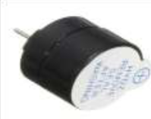
COMPONENTS INVOLVED :
MQ135:Gas
Sensor
MQ135:Gas
Sensor
DHT11:Tempareture and
Humidity Sensor
35:Gas
Sensor
ESP8266:Wifi
Module
ESP8266:Wifi
Module
Jumper Wires
Galli Buzzer

Slide 10
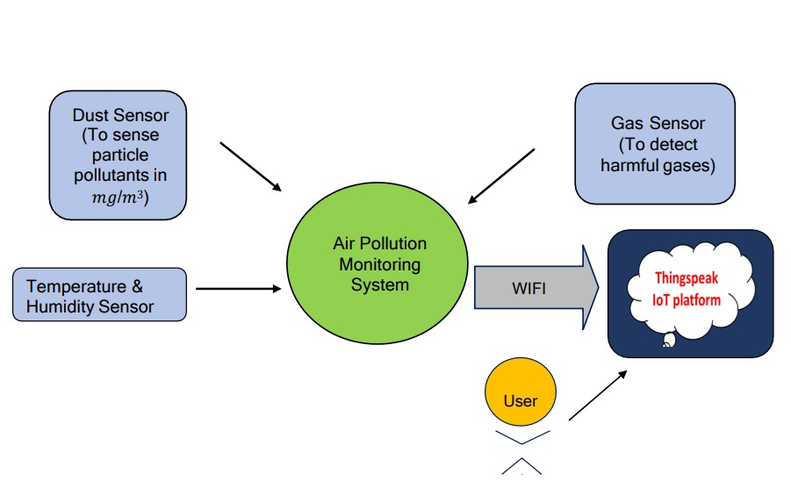
Block Diagram:

Slide 11
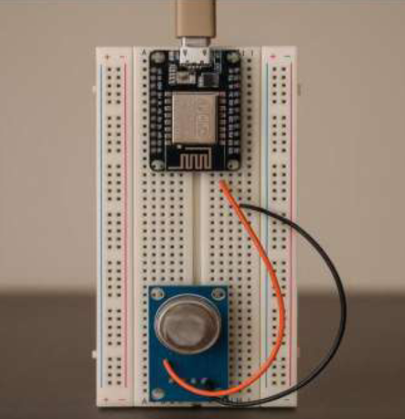
Connections:
Gas Sensor Connection
The system accurately measures the concentration of pollutants in the air using the MQ-135 sensor. It converts the gas concentrations into parts per million (PPM) levels, providing real-time data crucial for assessing air quality in both mining and urban environments.

Slide 12
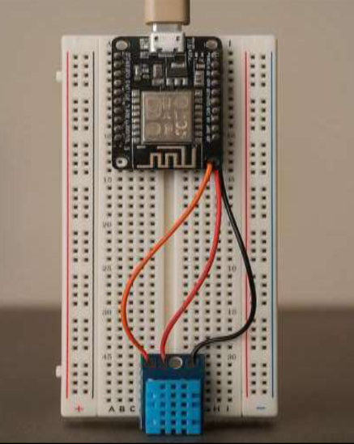
Connections
Temperature and Humidity Sensor Connection
The system accurately measures the ambient temperature and relative humidity using the DHT11 sensor. It converts the environmental data into digital signals, providing real-time readings that are essential for monitoring atmospheric conditions. This is particularly useful in applications such as weather stations, home automation, and agricultural environments.

Slide 13
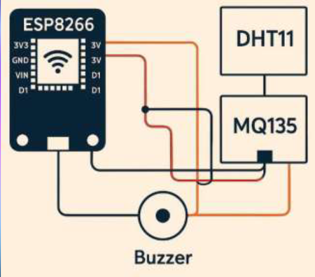
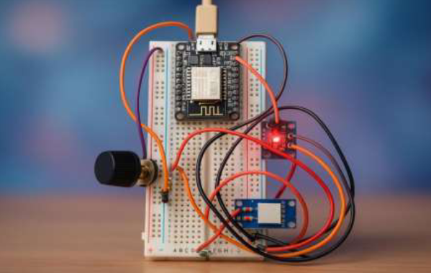
CIRCUIT DIAGRAM Schematic Connection: Actual Product:

Slide 14
DATA TRANSMISSION TO THINGSPEAK
The system utilizes the ESP8266 Wi-Fi module to transmit collected air quality data to Thing Speak, an IoT analytics platform. This allows for easy access, visualization, and analysis of air quality data from any location.

Slide 15
COST ESTIMATION:
Sl. No. | Component | Cost per unit (in ₹) | Units | Sub Total (in ₹)
1 | ESP8266(Wifi Module) | 200 | 1 | 200
2 | MQ135(Gas Sensor) | 100 | 1 | 100
3 | DHT11(Tempareture and Humidity Sensor) | 50 | 1 | 50
4 | Breadboard | 50 | 1 | 50
5 | Galli Buzzer | 10 | 1 | 10
6 | Jumper Wires | 1 | 10 | 10
Grand Total | 420

Slide 16
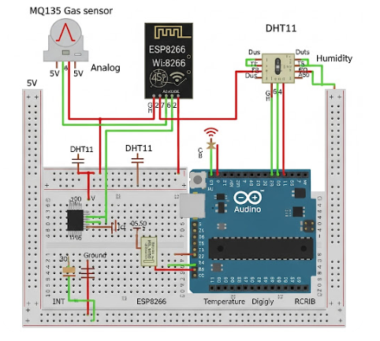
RESULT
Let us take a moment to understand the final outcomes of the project we have successfully completed. This achievement reflects our consistent efforts, teamwork, and problem-solving throughout the process. The results demonstrate the effectiveness of our approach and the goals we aimed to reach. It is important to analyze these outcomes to appreciate our progress and identify areas for future improvement.

Slide 17
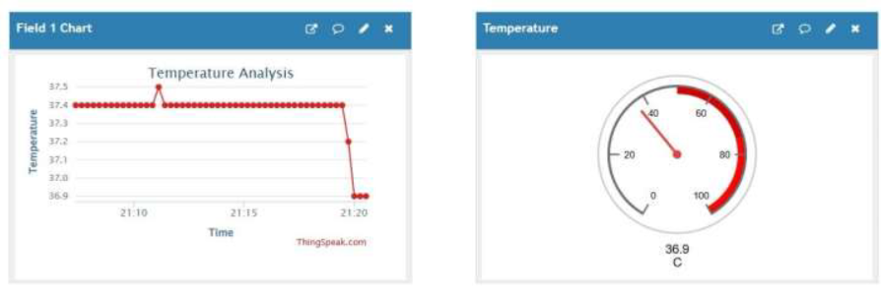
1. Temperature Monitoring Dashboard Showing Real-Time and Historical Data©.

Slide 18
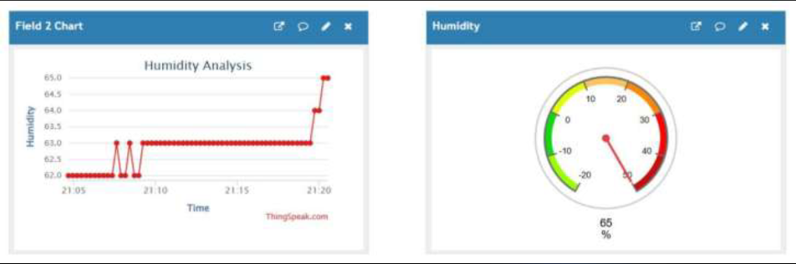
2. Humidity Monitoring Dashboard Showing Real-Time and Historical Data(%).

Slide 19
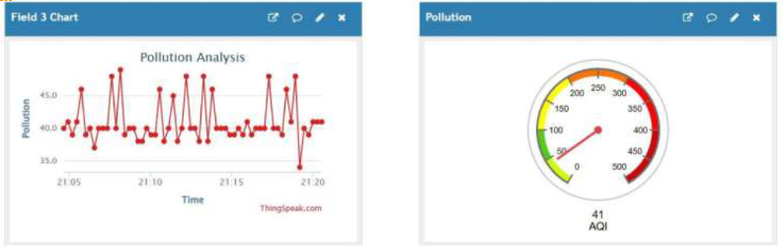
3. Pollution Monitoring Dashboard Showing Real-Time and Historical Data(AQI).

Slide 20
Alert Systems for Safety
The Mine Safety Device features an integrated alert system with a buzzer for audible warnings. It uses gas, temperature, and humidity sensors to monitor air quality in real time. When hazardous levels are detected, the buzzer alerts workers immediately. This is crucial in mining environments where poor air quality poses serious health risks. The system ensures timely response to dangerous conditions.

Slide 21
ADVANTAGES:
Hands-Free Control
Interactive
Usable for People with Limited Mobility
Customization
Potential for Expansion
Relatively Low Cost
Widely Available Resources

Slide 22
Future Work
Network Independence: Integrating GSM/4G or LPWAN (e.g., LoRa) can ensure continuous data transmission in areas with limited Wi-Fi access.
Real-Time Gas Absorption Mechanism: Real-time gas absorption using modules like activated carbon filters or chemical scrubbers can locally reduce pollution by identifying and neutralizing harmful gases.
Data Storage and Offline Functionality: Adding data storage (e.g., SD card) enables offline data collection and later upload when a network is available.
Location-Based Pollution Mapping: GPS tracking enables pollution heatmap creation and helps identify high-pollution areas for targeted intervention.

Slide 23
CONCLUSION:
The Mine Safety Device system utilizing MQ-135 sensor,DHT11 Sensor and ESP8266 not only enhances safety in mines but also serves a vital role in urban pollution assessment. Its real-time capabilities and user-friendly features position it as a critical tool for environmental monitoring.

Slide 24
REFRENCES
https://thingspeak.com/
BC, K., & Jose, D. (2018). IoT Based Pollution Monitoring System using Raspberry-PI. International Journal of Pure and Applied Mathematics, 118(24).
https://electronut.in/
Zakaria, N. A., Abidin, Z. Z., Harum, N., Hau, L. C., Ali, N. S., & Jafar, F. A. (2018). Wireless internet of things-based air quality device for smart pollution monitoring. Int. J. Adv. Comput. Sci. Appl, 9(11), 65-69
https://images.app.goo.gl/rXBryBXGpFfLW3yk6

Slide 25


